Slide 1

Chameleonic Dark Matter:
Implications for current and early Universe
December 28-31, 2018 @NCTS, Fu-Guang-Shan
5th International Workshop on Dark Matter, Dark Energy and Matter-Antimatter Asymmetry
Taishi Katsuragawa (桂川 大志)
華中師範大学 (Institute of Astrophysics, CCNU)
Reference
“Dark matter in modified gravity?” Phys. Rev. D95 044040 (2017)
“Cosmic History of Chameleonic Dark Matter in F(R) Gravity” Phys. Rev. D97, 064037 (2018)
“F(R) gravity in the early Universe: Electroweak phase transition and chameleon mechanism” [arXiv:1812.00640]
In collaboration with
Shinya Matsuzaki (Jilin U.), Eibun Senaha (IBS), Hua Chen (CCNU)

Slide 2
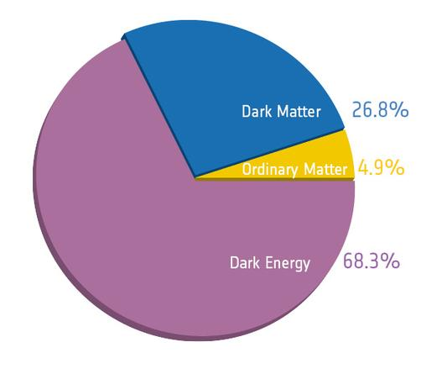
Outline of Our Research
Modified gravity can explain DM as well as DE?
Unification of Dark Side of the Universe
  Modified gravity is one solution to answer DE problem.
  Can we solve DM problem in the same framework?
New field from ``beyond-GR” (modification of gravity)
  Dynamical DE (Cosmological ``constant”→``Field”)
  Background to explain accelerated expansion
  ＋ Oscillation around background
  When oscillation is quantized, we obtain particle picture
  Particle picture of new field = New particle＝DM?
Interdisciplinary and challenging topic
  Possible solution to Coincidence Problem
  New application of modified gravity
  Study on new DM candidate

Slide 3



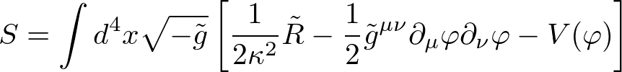
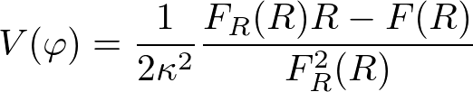


F(R) Gravity and Scalaron Field
F(R) Gravity Theory
F(R) gravity in Jordan frame: $g_{μν}$
cf.) EH-action
Replace:
Weyl trans.
F(R) gravity in Einstein frame: ${\tilde{g}}_{μν}$
where
New scalar field ”scalaron” $φ(x)$ appears from F(R)

Slide 4









Chameleon Mechanism
Chameleon mechanism in F(R) gravity
[Khoury and Weltman, (2004)] [Brax et. al (2008)]
Potential of scalaron field $V(φ)$ couples with trace of $T_{μν}$
Chameleon Mechanism
``Effective” mass
Large $ρ_{+}$
$$V_{eff}$$
(for dust)
$$m_{+}^{2}$$
$$V$$
In high-density region,
eff. mass becomes large.
c.f.) matter effect for neutrinos
Small $ρ_{−}$
$$m_{−}^{2}$$
→ ``Fifth force” is screened to agree with Solar-System constraint
$$κφ$$

Slide 5



Dark Matter in F(R) Gravity?
Scalaron Field ＝ Dynamical DE
  What about particle picture of scalaron?
  “Chameleon particle” [Burrage and Sakstein (2017)]
Scalaron’s Properties (as new particle)
SM singlet and massive scalar field
Very weak coupling to SM particles
Variable mass due to chameleon mechanism
What if scalaron is DM?
  ``Chameleonic” DM
  DE and DM are unified?
  It is nontrivial if one theory explains two problems...
$$V$$
DM
DE
$$κφ$$
$$κφ_{min}$$

Slide 6

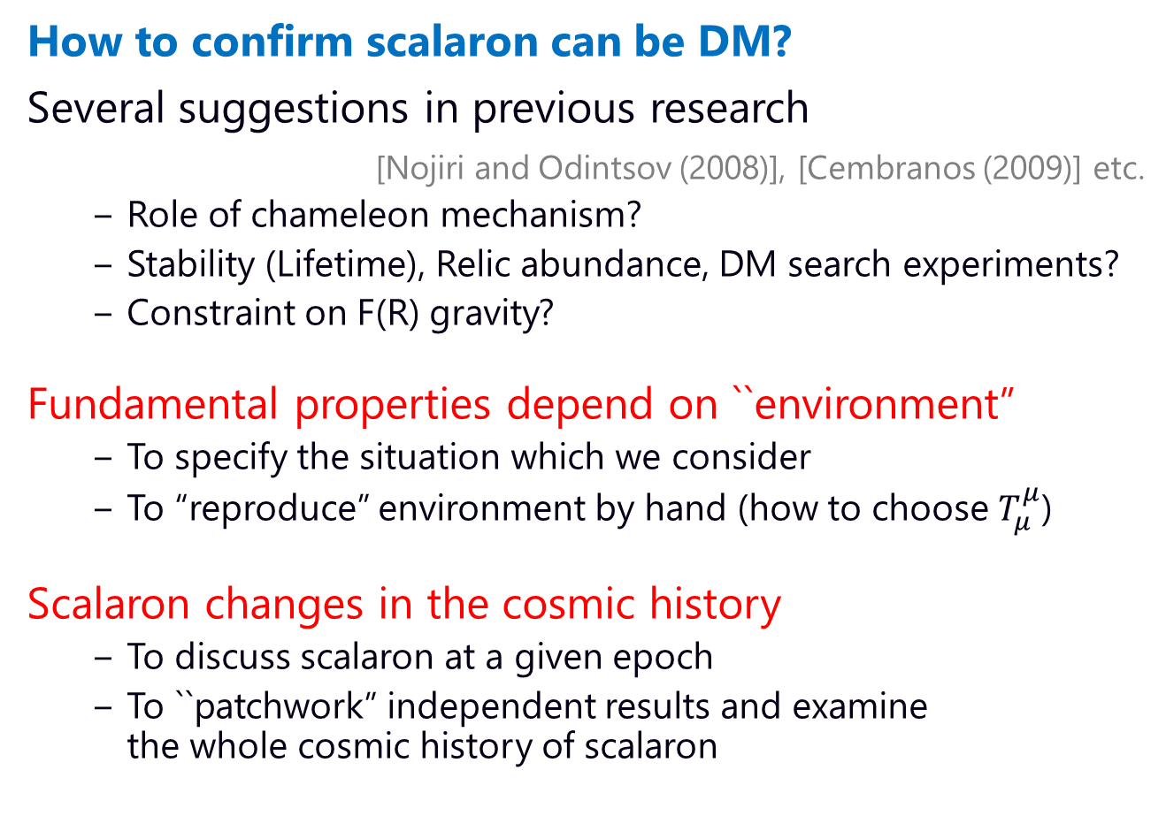
Strategy and Issues
How to confirm scalaron can be DM?
Several suggestions in previous research
[Nojiri and Odintsov (2008)], [Cembranos (2009)] etc.
  Role of chameleon mechanism?
  Stability (Lifetime), Relic abundance, DM search experiments?
  Constraint on F(R) gravity?
Fundamental properties depend on ``environment”
  To specify the situation which we consider
  To “reproduce” environment by hand (how to choose $T_{μ}^{μ}$)
Scalaron changes in the cosmic history
  To discuss scalaron at a given epoch
  To ``patchwork” independent results and examine the whole cosmic history of scalaron

Slide 7

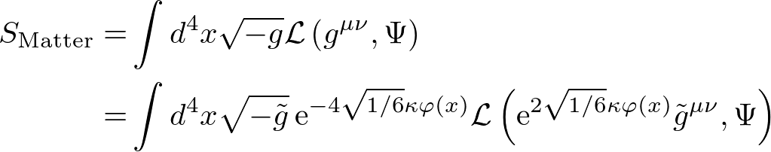

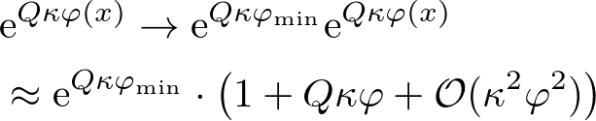

Matter Sector After Weyl Trans.
Dilatonic couplings with scalaron
If $κφ≪1$, the perturbative analysis is valid
If $κφ_{min}≪1$, frame-difference is not important
NB.) we find frame-difference is almost negligible
Matter Sector
exponential form
Frame-difference
Coupling to matter

Slide 8
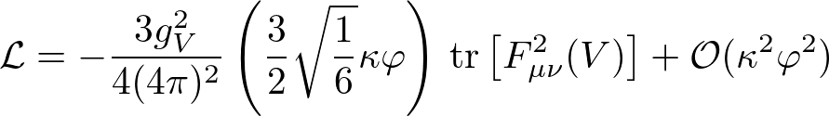




Matter Coupling
Scalaron universally couples with SM particles
For massless vector (Photon, Gluon)
Induced by anomaly
For photon
For gluon
Massive scalar field (Higgs)
Massive fermion (Quarks, Leptons)
Massive vector (Weak bosons)

Slide 9
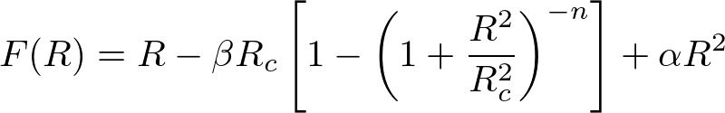
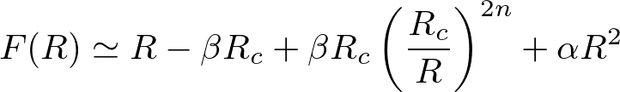


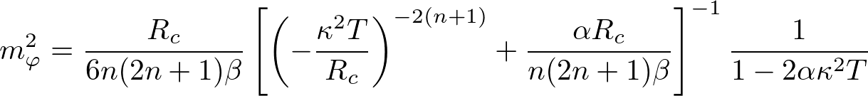
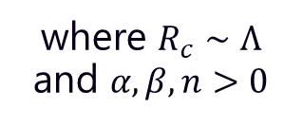


F(R) Model and Scalaron Mass
Environment-dependence in scalaron mass
In large-curvature limit $R>R_{c}$
Starobinsky model with $R^{2}$ correction
where $R_{c}∼Λ$ and $α, β,n>0$
GR
to cure singularity problem
Viable F(R) gravity model for DE
[Frolov (2008)] [Dev et al. (2008)]
[Starobinsky (2007)]
where
Scalaron mass
Notes:
(chameleon mechanism works in high-density region)

Slide 10
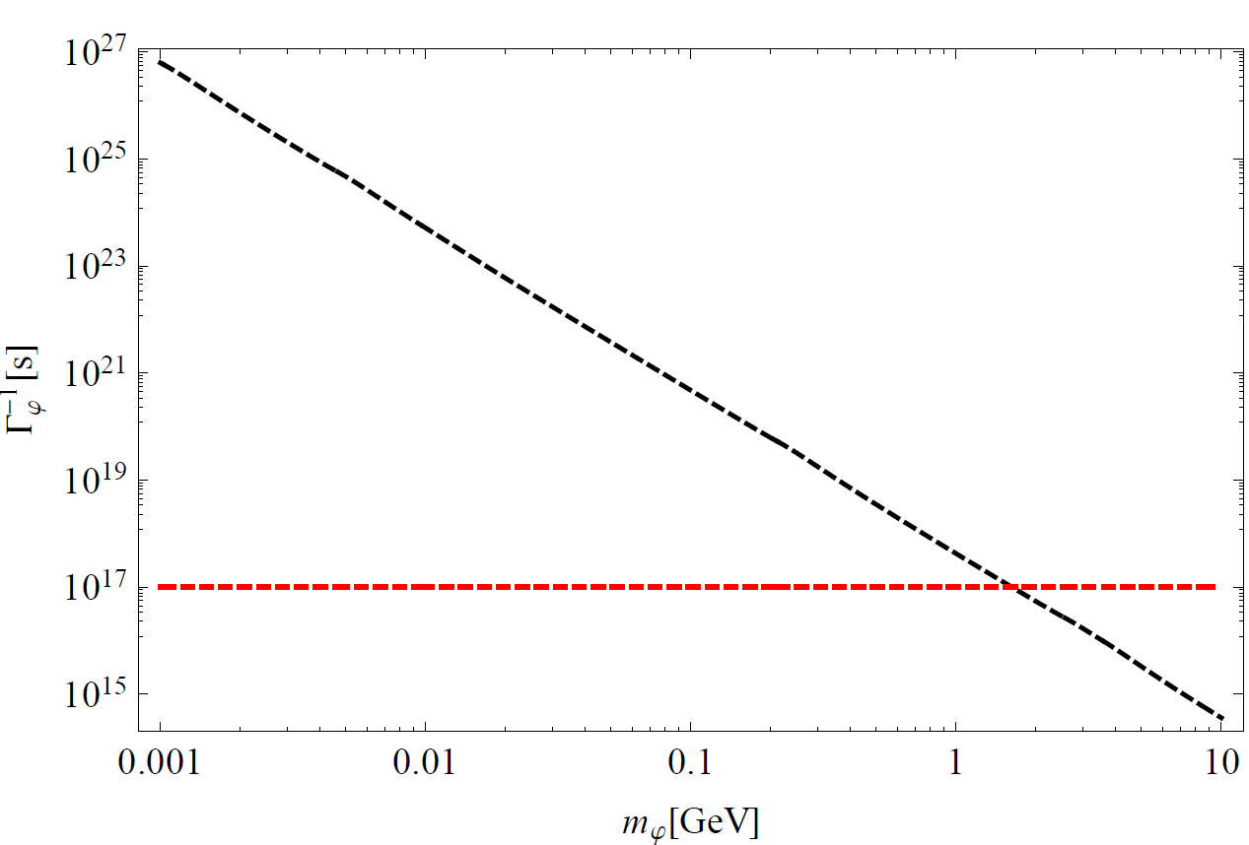



Stability in Late-time Universe
Scalaron lifetime in the late-time Universe
Scalaron mainly decays into diphoton in late-time because scalaron mass becomes smaller and smaller.
Lifetime $Γ_{φ}^{−1}≥{10}^{17}[s]$ (age of Universe) → $m_{φ}<O(1)[GeV]$
  In late-time Universe, the scalaron mass should be smaller than $O(1) [GeV]$
  Consistent with F(R) model for DE?
$$φ→γγ$$
${10}^{17}$[s]

Slide 11

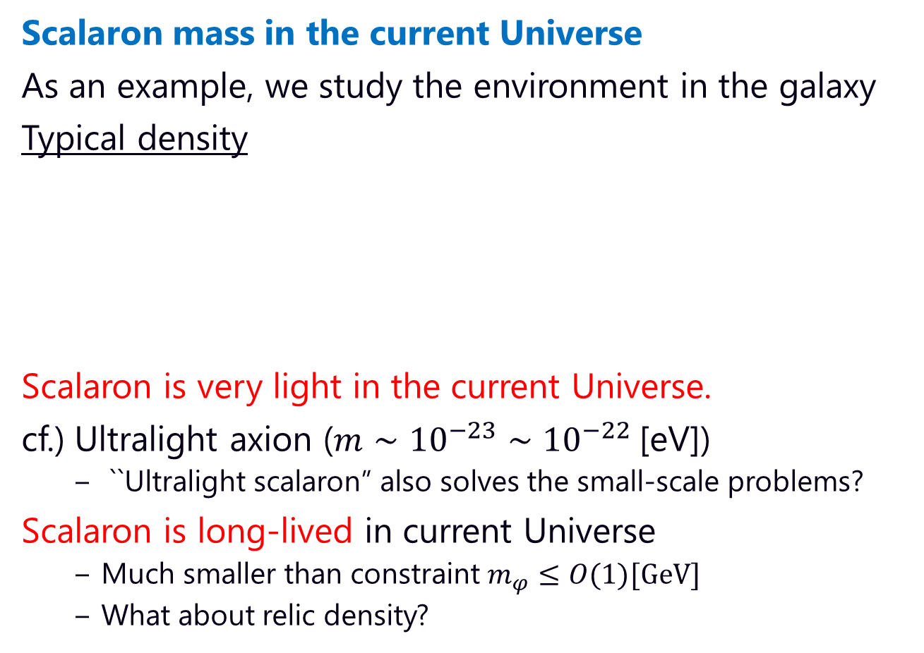
Scalaron Mass in Current Universe
Scalaron mass in the current Universe
As an example, we study the environment in the galaxy
Typical density
Scalaron is very light in the current Universe.
cf.) Ultralight axion ($m∼{10}^{−23}∼{10}^{−22}$[eV])
  ``Ultralight scalaron” also solves the small-scale problems?
Scalaron is long-lived in current Universe
  Much smaller than constraint $m_{φ}≤O(1)[GeV]$
  What about relic density?
Scalaron mass
in typical galaxies

Slide 12



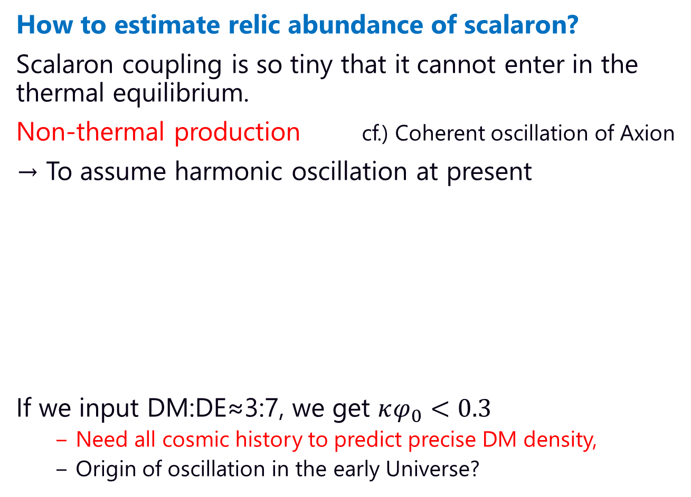



Scalaron Relic Density
How to estimate relic abundance of scalaron?
Scalaron coupling is so tiny that it cannot enter in the thermal equilibrium.
Non-thermal production cf.) Coherent oscillation of Axion
→ To assume harmonic oscillation at present
If we input DM:DE≈3:7, we get $κφ_{0}<0.3$
  Need all cosmic history to predict precise DM density,
  Origin of oscillation in the early Universe?
$$V$$
Amplitude $≪1$
DM
DE
DE
At present
$$κφ_{min}$$
DM
$$κφ$$

Slide 13

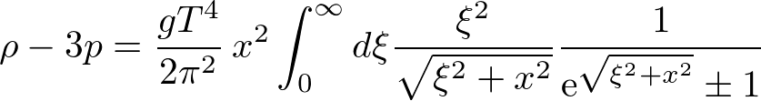

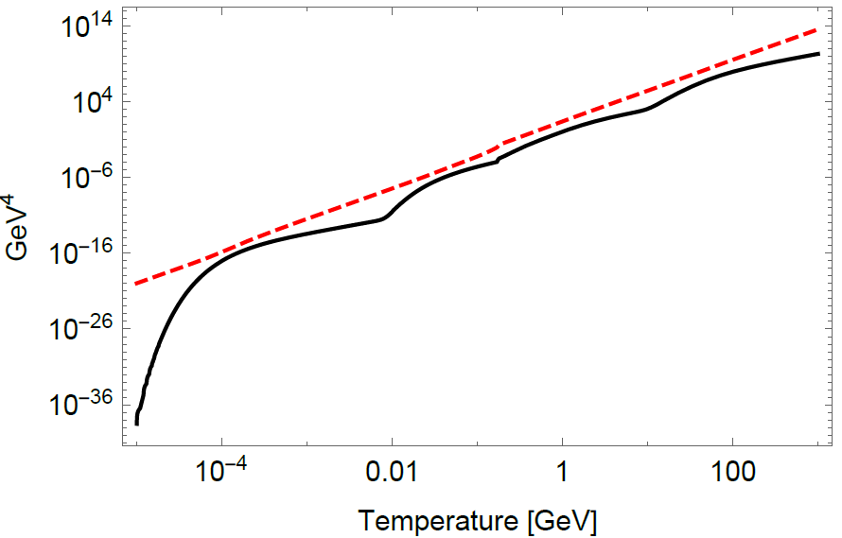


Cosmic Environment in Early Universe
To construct the time evolution of $T_{μ}^{μ}=−(ρ−3p)$
Perfect Fluid Approximation
Sum over all SM species
NB.) For Radiation
We deal with neutrinos as radiation
$ρ−3p$ and $ρ$

Slide 14
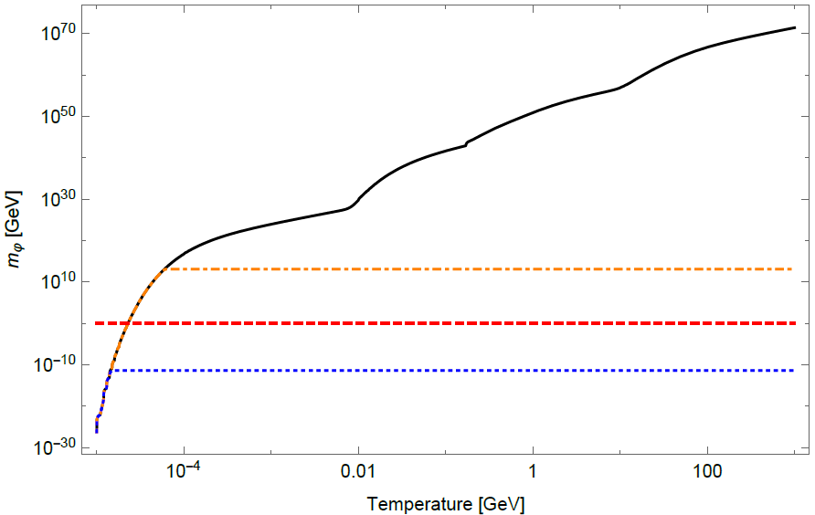




Scalaron Mass in Early Universe
Scalaron is heavy in the early Universe
Scalaron is (very) massive in the early Universe
  Environment maintains only in short time ($≪1\left[s\right]≪{10}^{17}[s]$)
  Scalaron mass $m_{φ}≥O(1)[GeV]$ may be allowed (?)
For $n=1, β=2,R_{c}=Λ$ cf.) $βR_{c}=2Λ$
(original) Starobinsky model
Inflation
experimental bound
time
[Adelberger et. al (2006)]
[Berry and Gair (2011)]
Notes:
Instability in early-time<< Stability in late-time

Slide 15


Scalaron in EWPT BG Environment
Beyond-SM environment for $T_{μ}^{μ}$
We consider SI-extension of SM as a reference scenario
SI-2HDM [Fuyuto, Senaha (2015), Fuyuto, Hou, Senaha (2018)]
  Strong 1st-order PT for EW sym. as well as scale sym.
  Realistic amount of BAU by EWBG
Scalaron potential suddenly changes after EWPT
  Matter-sector ``kicks” scalaron, to start the oscillation (?)
Perfect fluid approx.
SI-2HDM with resum.
SI-2HDM without resum.
SI suggests $T_{μ}^{μ}=0$ before EWPT
→ NO chameleon mechanism

Slide 16

Summary and Discussion
We studied scalaron as new DM candidate
Interaction to SM particles
  Very weak and suppressed by Planck mass scale
  No thermal production (out of thermal equilibrium)
Chameleonic properties
  Very light in current Universe, heavy in early Universe
  If SI is realized in early Universe, very light before EWPT
Stability and Lifetime
  Decaying modes to SM particles
  Long enough to be DM candidate at late-time
Relic Abundance
  Estimation based on coherent oscillation
  Potential origin of oscillation in EWPT
  Possibility to address the coincidence problem

Slide 17

Thank you!

Slide 18

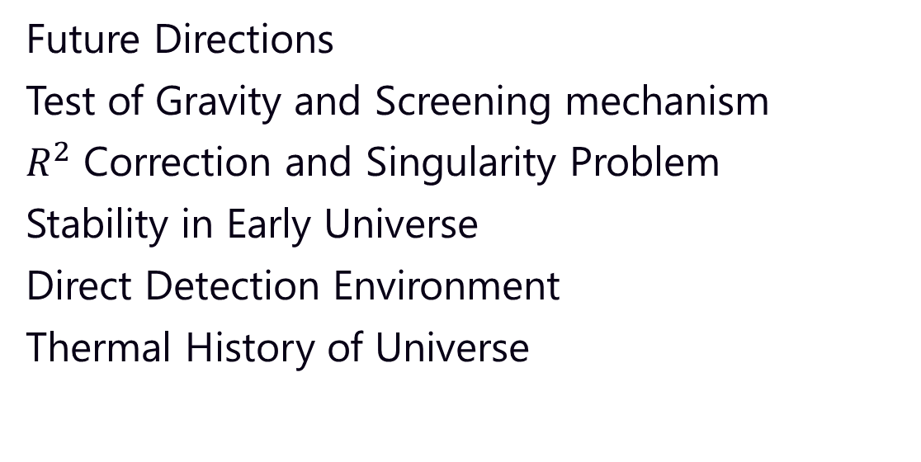
Appendix
Future Directions
Test of Gravity and Screening mechanism
$R^{2}$ Correction and Singularity Problem
Stability in Early Universe
Direct Detection Environment
Thermal History of Universe

Slide 19
Future Directions
There are still many mysteries to be addressed
In early Universe
BBN constraint?
  Scalaron would affect BBN
  BBN constraint is converted into the constraint on F(R) gravity
Stability and lifetime?
In late-time Universe
Coupling b/w DM & DE?
  DM and DE are unified as scalaron → to arise interactions
  There is energy transfer in dark sector
  To embed into interacting DE model [Farrar and Peebles (2004)]
(In-)Direct detection (to distinguish other candidates)?
and so on…
BBN

Slide 20
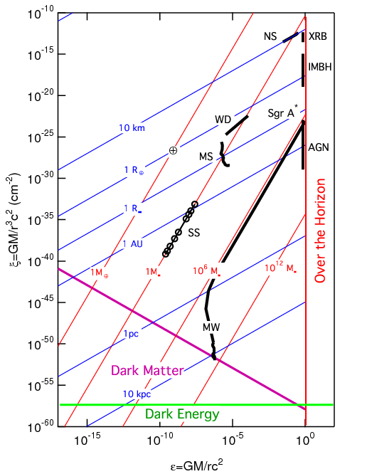
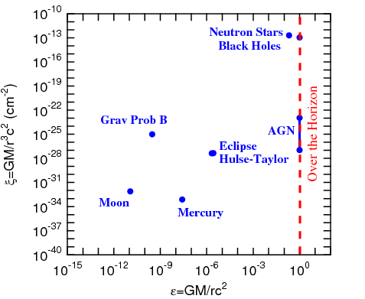
Test of Gravity and Screening Mechanism
GR
Curvature
Screening Mechanism
Screening mechanism is a key to avoid the constraints on the fifth force!
Modified Gravity
Newton Potential
Psaltis (2008)

Slide 21
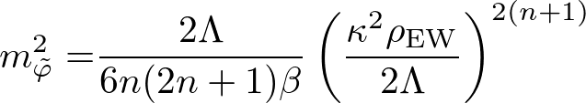
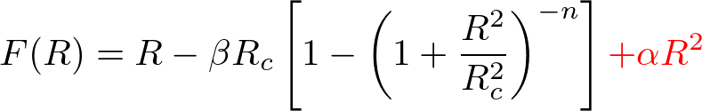








$R^{2}$ Correction and Singularity Problem
Singularity problem in F(R) Gravity
In order to prevent the scalaron mass from reaching Planck mass, we add the $R^{2}$ term
Large $T_{μ}^{μ}$
$$V_{eff}(φ)$$
[Frolov (2008)] [Kobayashi and Maeda (2008)] [Dev et al. (2008)]
$T_{ μ}^{μ}$ increases
$$φ=0 ⟷R=∞$$
Potential minimum
Small $T_{μ}^{μ}$
$m_{φ}≫M_{pl}$
in early Universe!
$$κφ$$

Slide 22
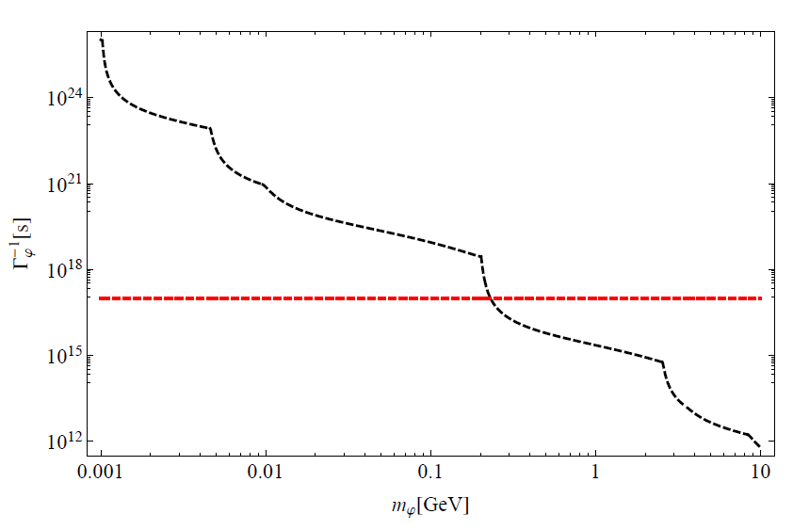









Stability in Early Universe
Scalaron lifetime in the Early Universe
The epoch after EW phase trans. before QCD phase trans.
Lifetime $Γ_{φ}^{−1}≥{10}^{17}[s]$ (age of Universe) → $m_{φ}≤0.23[GeV]$
  Bound becomes tight due to large # of decay modes
  Environment maintains only in very short time
  Constraint is also valid in very short time → meaningless?
$$γγ, gg$$
$$e^{−}e^{+}$$
$$u\overline{u}$$
$$d\overline{d}$$
$$s\overline{s},μ\overline{μ}$$
$$c\overline{c}, τ\overline{τ}$$
${10}^{17}$[s]
$$b\overline{b}$$

Slide 23
Direct Detection Environment
Direct Detection
  DM is detected by collision with nuclei.
  Chameleon mechanism is characterized by the property of target matter.
The effective model for each experiments?
  Interatomic distance or density of target matter
  Target-matter dependence of observables
  Specific signal at the surface of target matter?
Target matter
?
heavy
light
Different environment

Slide 24
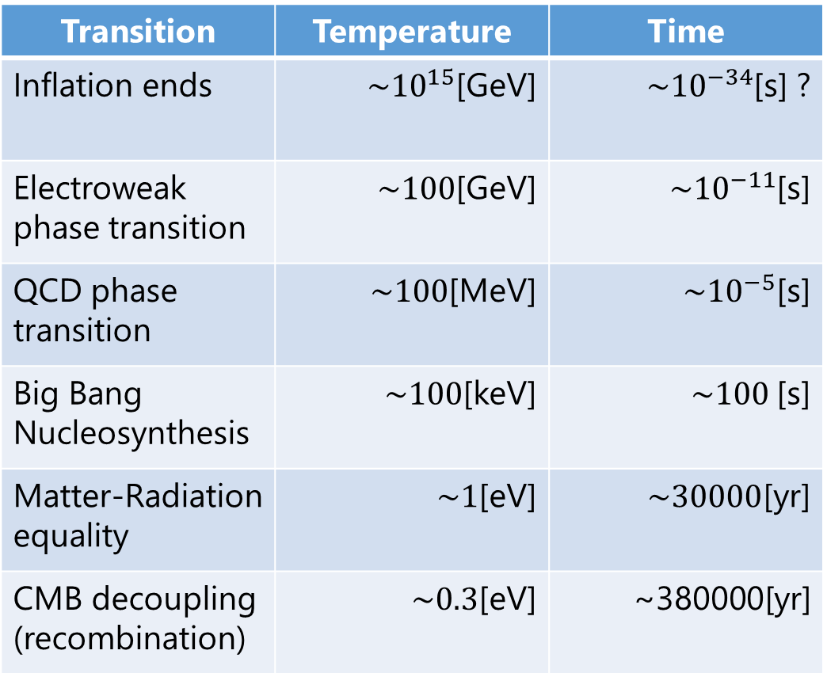
Thermal History of the Universe
HOT
Transition | Temperature | Time
Inflation ends | $\sim {10}^{15}$[GeV] | $\sim {10}^{−34}$[s] ?
Electroweak phase transition | $\sim 100$[GeV] | $\sim {10}^{−11}$[s]
QCD phase transition | $\sim 100$[MeV] | $\sim {10}^{−5}$[s]
Big Bang Nucleosynthesis | $\sim 100$[keV] | $\sim 100$[s]
Matter-Radiation equality | $\sim 1$[eV] | $\sim 30000$[yr]
CMB decoupling (recombination) | $\sim 0.3$[eV] | ~380000[yr]
COLD

